Slide 1
Programming fundamentals
Section 9

Slide 2
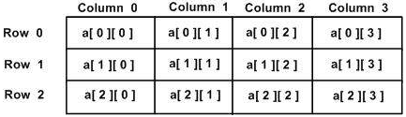
Two-Dimensional Arrays
General Form:
type arrayName [ x ][ y ];
A two-dimensional array can be think as a table, which will have x number of rows and y number of columns. A 2-dimensional array a, which contains three rows and four columns can be shown as below −

Slide 3
Two-Dimensional Arrays
Initializing Two-Dimensional Arrays
Multidimensional arrays may be initialized by specifying bracketed values for each row. Following is an array with 3 rows and each row have 4 columns.
int a[3][4] = { { 0, 1, 2, 3 }, /* initializers for row indexed by 0 */ { 4, 5, 6, 7 }, /* initializers for row indexed by 1 */ { 8, 9, 10, 11 } /* initializers for row indexed by 2 */ };

Slide 4
Two-Dimensional Arrays
Initializing Two-Dimensional Arrays
The nested braces, which indicate the intended row, are optional. The following initialization is equivalent to previous example −
int b[3][4] = { 0, 1, 2, 3, 4, 5, 6, 7, 8, 9, 10, 11 };

Slide 5
Two-Dimensional Arrays
Initializing Two-Dimensional Arrays
int matrix[2][2]; matrix[0][0] = 43; matrix[0][1] = 44; matrix[1][0] = 56; matrix[1][1] = 72;

Slide 6
Two-Dimensional Arrays
Initializing Two-Dimensional Arrays
#include<iostream> using namespace std; void main() { int arr[10][10], row, col; cout << "Enter How many Rows and columns in the array "; cin >> row >> col; cout << "Enter Array elements: “; for (int i = 0; i<row; i++) { for (int j = 0; j<col; j++) { cin >> arr[i][j]; } | } cout << endl; cout << "your array Elements: "; for (int i = 0; i < row; i++) { cout << endl; for (int j = 0; j < col; j++) { cout << arr[i][j]<<" "; } } cout << endl; system("Pause"); }

Slide 7
Sum Elements of 2 arrays
#include <iostream> using namespace std; void main() { int arr1[3], arr2[5]; cout << "Enter First array"; for (int i = 0; i < 3; i++) cin >> arr1[i]; cout << endl<< "enter second array "; for (int i = 0; i < 5; i++) cin >> arr2[i]; for (int i = 0; i < 5; i++) arr2[i] += arr1[i]; cout << endl <<" sum of 2 arrays is "; for (int i = 0; i < 5; i++) cout << arr2[i]<<" "; system("Pause"); }

Slide 8
Arrays as Parameters
At some moment we may need to pass an array to a function as a parameter.
returnType FunctionName(int A[], int length)
when we call the function:
FunctionName(A, length);

Slide 9
Function to Sort an Array
#include<iostream> using namespace std; void sort(int Arr[], int size) { int I, J, Temp; for (I = 0; I<size - 1; I++) { for (J = 0; J<(size - 1 - I); J++) if (Arr[J]>Arr[J + 1]) { Temp = Arr[J]; Arr[J] = Arr[J + 1]; Arr[J + 1] = Temp; } | } } void main() { int arr[5]; cout << "enter array elements"; for (int i = 0; i < 5; i++) { cin >> arr[i]; } sort(arr, 5); cout << "array after sort : "<<endl; for (int i = 0; i < 5; i++) { cout<< arr[i]; } system("Pause"); }

Slide 10
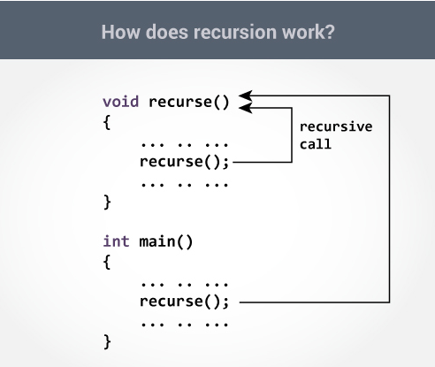
Recursion
A function that calls itself is known as a recursive function. And, this technique is known as recursion.

Slide 11
Sum of array Elements using recursion
#include<iostream> using namespace std; float sum(float arr[], int length) { if (length <= 0) return 0; return arr[length - 1] + sum(arr, length - 1); } | void main() { float arr[5]; cout << "enter the degree of 5 subjects"; for (int i = 0; i < 5; i++) cin >> arr[i]; cout << "Sum of your degrees are: " << sum(arr,5)<<endl; system("Pause"); }

Slide 12
Sheet Function no. 7
#include <iostream> using namespace std; int gcdFunc(int a, int b) { int gcd = 0; if (a<=0 || b <= 0) { gcd = 0; } else { for (int i = 1; i <= a; i++) { if (a%i == 0 && b%i == 0) gcd = i; } } return gcd; } | void main() { int a, b; cout << "enter 2 numbers: "; cin >> a >> b; if (a > b) { int c = a; a = b; b = c; } cout<< gcdFunc(a, b); system("Pause"); }

Slide 13
Practical Exam (Sample)
#include <iostream> using namespace std; void main() { int numbers[5], sum = 0; cout << "Enter 5 numbers: "; //Write a program to store and calculate the sum of 5 numbers entered by the user using arrays. /////////// cout << "Sum = " << sum << endl; }

Slide 14
Practical Exam (Sample)
#include <iostream> using namespace std; // write function to get smallest number ////////////////////// void main() { int x, y; cout << "Enter x: "; cin >> x; cout << "Enter y: "; cin >> y; GetSmallestNo(x, y); }

Slide 15
Practical Exam (Sample)
#include <iostream> using namespace std; //write a Function to get the sum of two numbers. //////////// void main() { int num1, num2; cout<<"Enters two numbers to add: "; cin >> num1 >> num2; add(num1,num2); }

